Slide 1


SAVVY+
Make Friends, Make Money
Ellipsis Tech Series 2020 – Hackathon
Team number: H-07
Team Name: 4 Yes, 1 No
Notes:
Problem statement Interpretation
Target Audience + Objective
Solution
Solution Components - 4 key layers
Profiling, Learn & Explore, Social Media Platform, Gamification
Rationale
Tech Stack + maybe discuss 1 key consideration / trade off
Conclusion + Thanks

Slide 2
Problem Statement
Many youths today have not kickstarted their financial planning journey, despite the vast amounts of information available. Some find the large volume of information too overwhelming, while others do not know how and where to begin.
Target Audience
Our solution targets 2 main groups of youth: Those not have not started financial planning, and those who have just taken their first steps on this journey (less than 3 months experience).
Objective
To create a one-stop platform that provides youths with easy access to simple yet useful learning resources, an online community of like-minded individuals and engaging tools to track their learning progress.
Notes:
Problem statement Interpretation

Slide 3
Financial Competency
Completely new to financial planning
Just began learning financial planning
4
Basic Financial Literacy
3
2
Our Solution
1
Savvy+ comprises 4 key features that enable youth to attain basic financial literacy in a progressive manner
Features
Financial Profiling
Learn / Explore
Community & Social Media
Gamification Experience
Notes:
Solution Components - 4 key layers
Profiling, Learn & Explore, Social Media Platform, Gamification

Slide 4

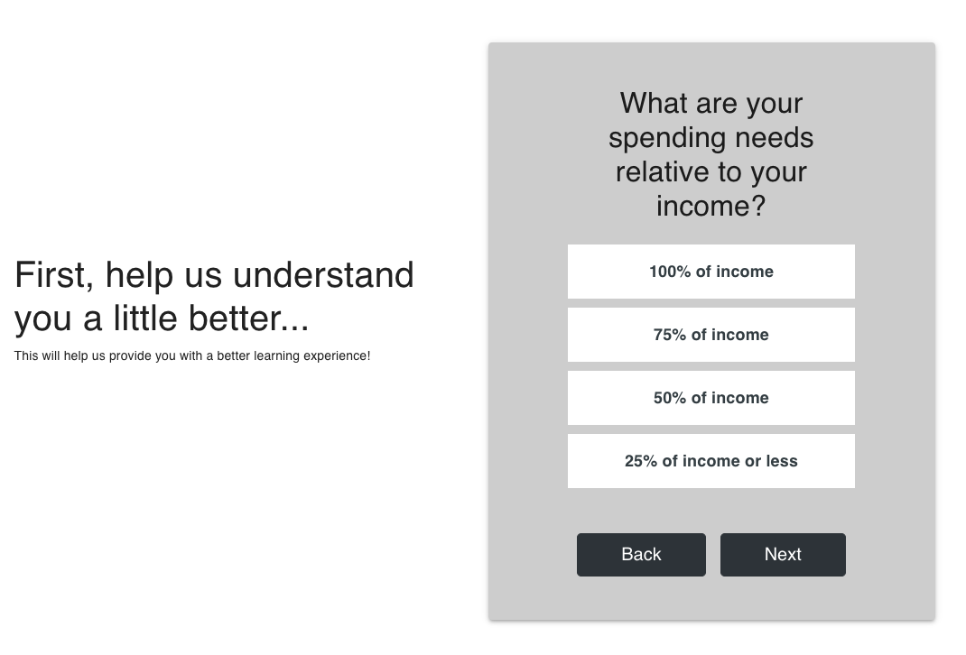
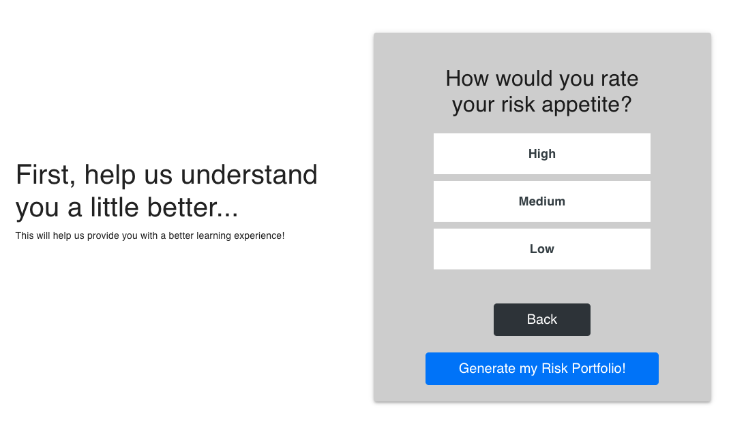
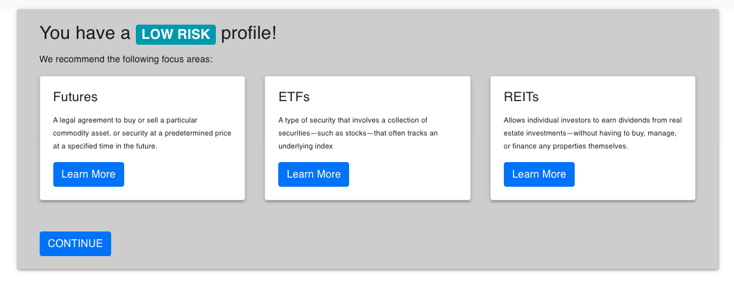
Key Feature I – Financial Profiling
For new users, we perform a short user profiling survey to curate personalized content tailored to their risk profiles and better shape their learning experience
Notes:
Target Audience + Objective

Slide 5
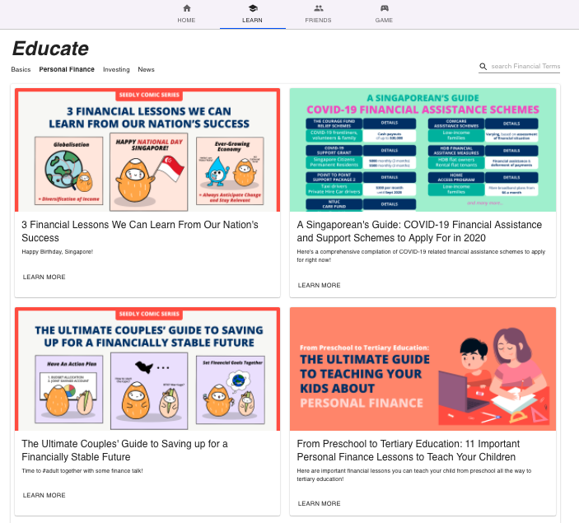
Key Feature II – Learn & Explore
We recognize that the vast amount of unorganized information is an obstacle for many youths to embark on their financial planning journey. To alleviate this, we created the Learn and Explore function as one of our key features.
Under Learn and Explore, we organized the vast amount of financial materials into distinct categories that allow users to easily find materials based on their needs.
If unsure of where to locate material, users can also type their queries into the search bar on the top right!
Notes:
Thanks

Slide 6
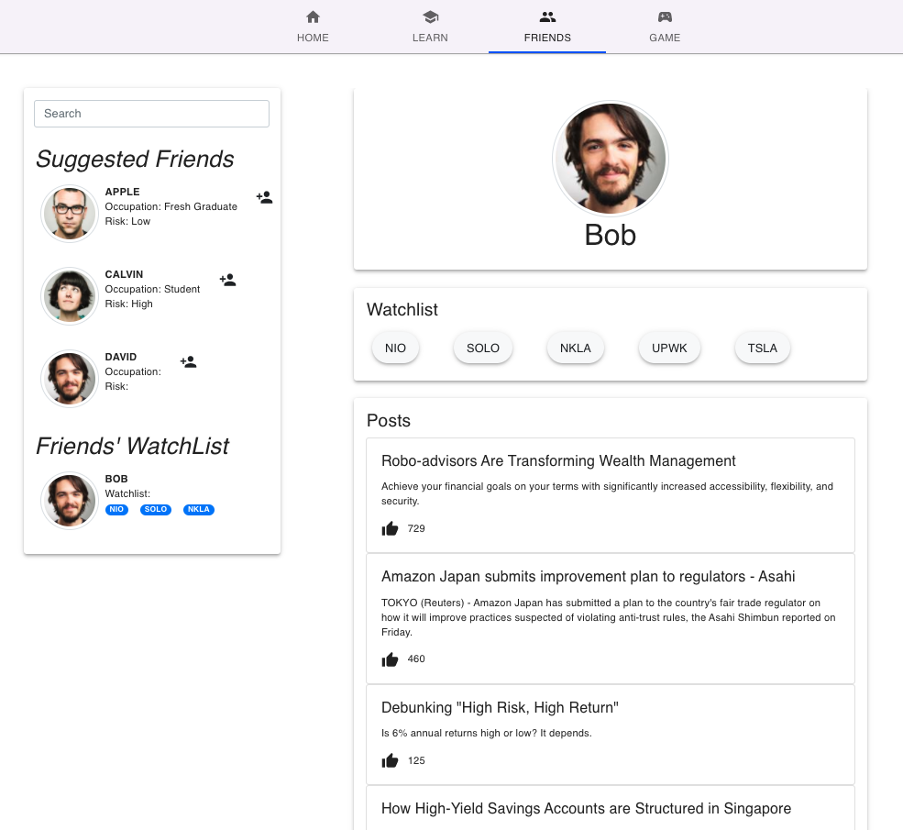
Key Feature III – Community & Social Media
When starting on their learning journey, youths tend to have many questions, but find it difficult to seek help and improve as there is a lack of a supportive community.
As such we developed the Friends tab to mimic a social media environment where youths can have their questions answered, share interesting financial posts and interact with like-minded individuals.
Notes:
Target Audience + Objective

Slide 7
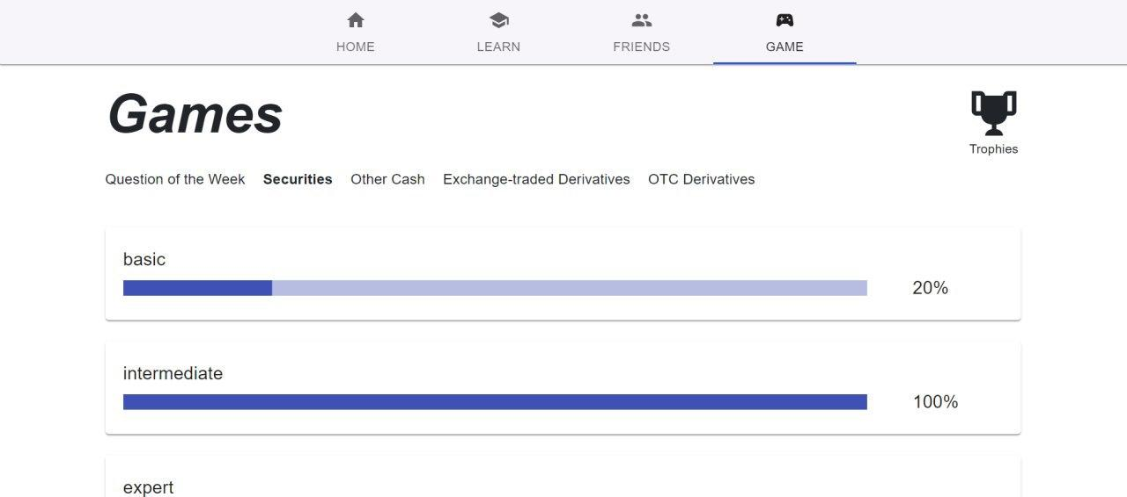
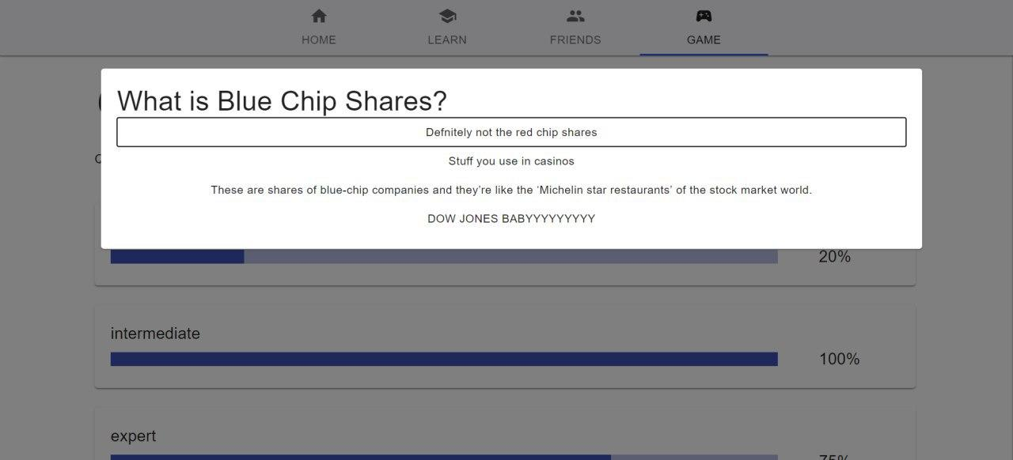
Key Feature IV – Gamification
As learning tends to be long, mundane and arduous, we deemed it necessary to make learning interactive on our platform.
We gamified the user’s learning experience by having lightning quizzes under the Game tab to test their knowledge. We also provide incremental rewards to encourage continuous engaged learning.
Additionally, users will be able to harness the community-based feature to interact with others regarding the questions that they face difficulty with or find interesting.
Notes:
Rationale
Learn about investments with like-minded individuals

Slide 8

Tech Stack
Architecture
Microservice based API
Static web hosting
Business logic running on independent EC2 instances with sufficient gunicorn workers and appropriate timeouts
Sufficient redundancies with AWS Classic Load Balancer
Relational database (mySQL) managed by AWS RDS
Front-end user interface compressed and minimized running on S3 static web hosting technology
Frontend:
ReactJS
Bootstrap
Material-ui
Nivo.rocks
Backend:
Python
Amazon RDS
AWS EC2 Instance
Libraries Used
Flask
Gunicorn
Yfinance
BeautifulSoup4
3rd Party APIs
Yahoo finance
Notes:
Tech Stack + maybe discuss 1 key consideration / trade off

Slide 9

Conclusion
Roles
Ong Jun Xiang – Frontend Development
Sherman Lee – Frontend Development
Zexel Lew – Backend
Kelvin – Backend Developement
Rachel Lui – UI/UX Designer
We would like to thank Goldman Sachs and Ellipsis for organizing this amazing Tech Series Hackathon and AWS for the $100 E-Credits to deploy our systems.
Notes:
conclusion

Slide 10
Thank You
Notes:
Thanks

